Slide 1
Welcome!
Course Materials:
http://bit.ly/ArchNLP19
Memory Lives on Conference -- UCSF
October 4, 2019

Slide 2
Welcome!
Today’s Schedule:
8:30 - 9:00 am -- breakfast and coffee
9:00 - 10:00 am -- introducing the data
10:00 - 10:30 am -- introducing the unix shell to open a jupyter notebook, and load data into pandas dataframe.
10:30 - 10:45 am -- break
10:45 am - 11:15 am -- NLP Introduction
11:15 am - 12:00 pm -- NLP Walkthrough

Slide 3
No More Silence
“The Data” of Opening the Data of the HIV/AIDS Epidemic
Memory Lives on Conference -- UCSF
October 4, 2019

Slide 4
What is this project?
No More Silence, in a nutshell
Extract text from digitized archival documents on HIV/AIDS epidemic
Organizational records, personal papers, printed ephemera, government records, legal records, etc.
Create single dataset which pairs this text with the archival metadata for each document.
i.e. “Author”, “Collection title”, “Date range”, “Subject”, etc.
Deposit data in Dryad data repository
Facilitate use of data for pilot research projects

Slide 5
What are these documents?
What archival collections documents look like
Organizational records
meeting minutes
flyers
Personal papers
writings/diaries
correspondence
Government/legal records
legal testimony / briefings
government proceedings
AND MORE

Slide 6
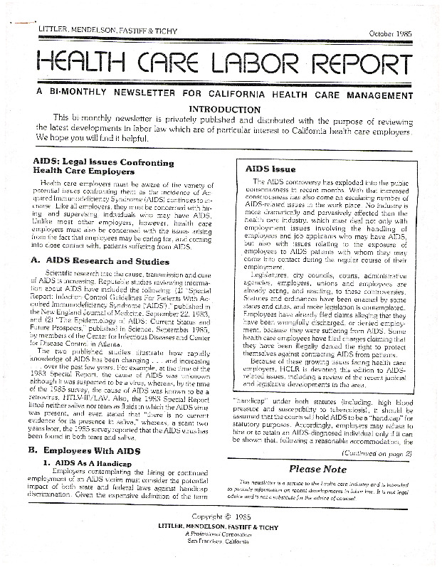
What are these documents?
What archival collections documents look like
Organizational records
meeting minutes
flyers
Personal papers
writings/diaries
correspondence
Government/legal records
legal testimony / briefings
government proceedings
AND MORE

Slide 7
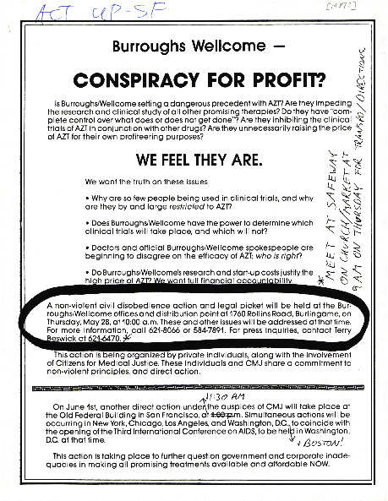
What are these documents?
What archival collections documents look like
Organizational records
meeting minutes
flyers
Personal papers
writings/diaries
correspondence
Government/legal records
legal testimony / briefings
government proceedings
AND MORE

Slide 8
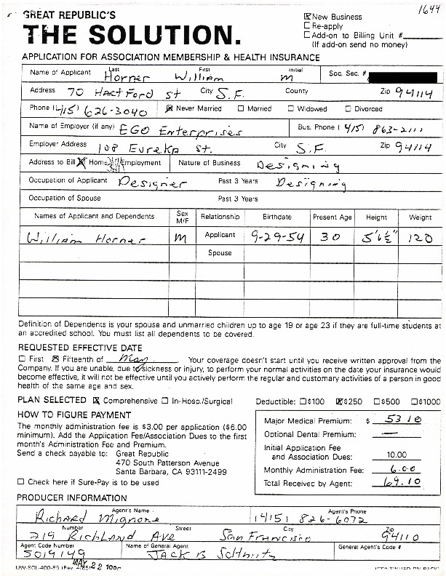
What are these documents?
What archival collections documents look like
Organizational records
meeting minutes
flyers
Personal papers
writings/diaries
correspondence
Government/legal records
legal testimony / briefings
government proceedings
AND MORE

Slide 9
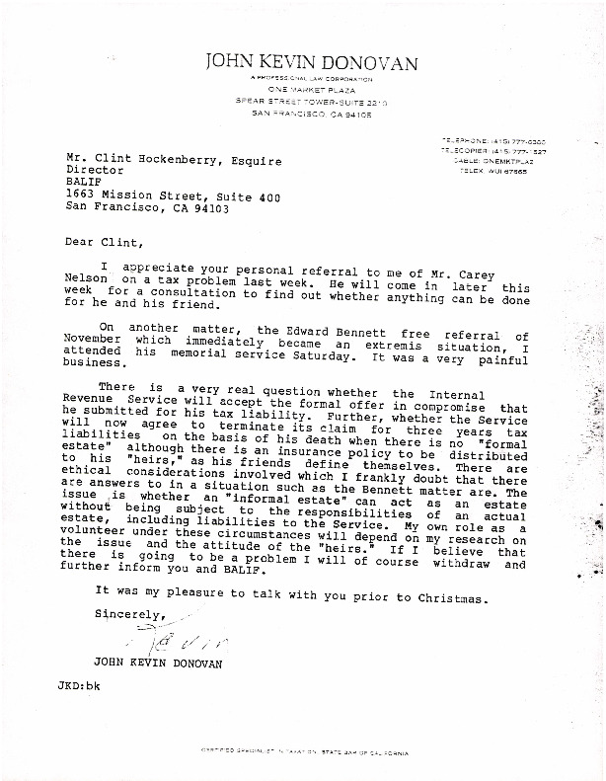
What are these documents?
What archival collections documents look like
Organizational records
meeting minutes
flyers
Personal papers
writings/diaries
correspondence
Government/legal records
legal testimony / briefings
government proceedings
AND MORE

Slide 10
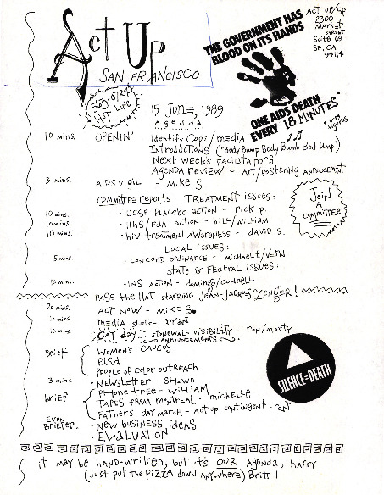
What are these documents?
What archival collections documents look like
Organizational records
meeting minutes
flyers
Personal papers
writings/diaries
correspondence
Government/legal records
legal testimony / briefings
government proceedings
AND MORE

Slide 11
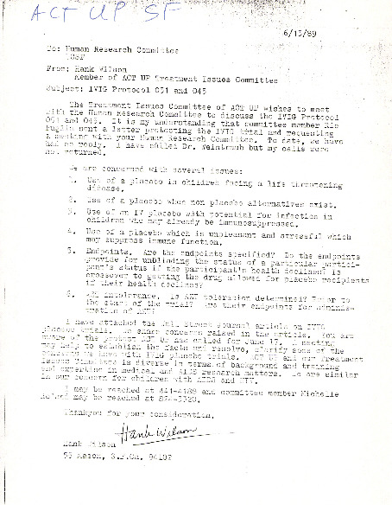
What are these documents?
What archival collections documents look like
Organizational records
meeting minutes
flyers
Personal papers
writings/diaries
correspondence
Government/legal records
legal testimony / briefings
government proceedings
AND MORE

Slide 12
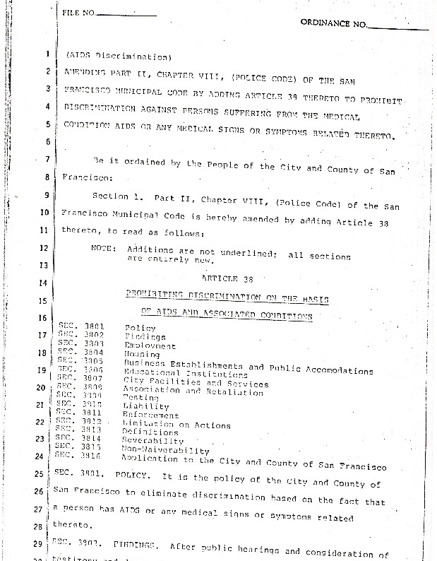
What are these documents?
What archival collections documents look like
Organizational records
meeting minutes
flyers
Personal papers
writings/diaries
correspondence
Government/legal records
legal testimony / briefings
government proceedings
AND MORE

Slide 13
What’s in the data?
Compilation of the actual dataset
Archival Metadata, extracted from the software we use to preserve and provide access to our digitized collections.
fields like “Creator”, “Collection Title”, “Call No.”, “Date Range”
metadata which has been created by a person doing the cataloging
The full text of the document itself.
extracted using Optical Character Recognition software
uncorrected, which mean that is is very messy and often mis-transcribed.

Slide 14
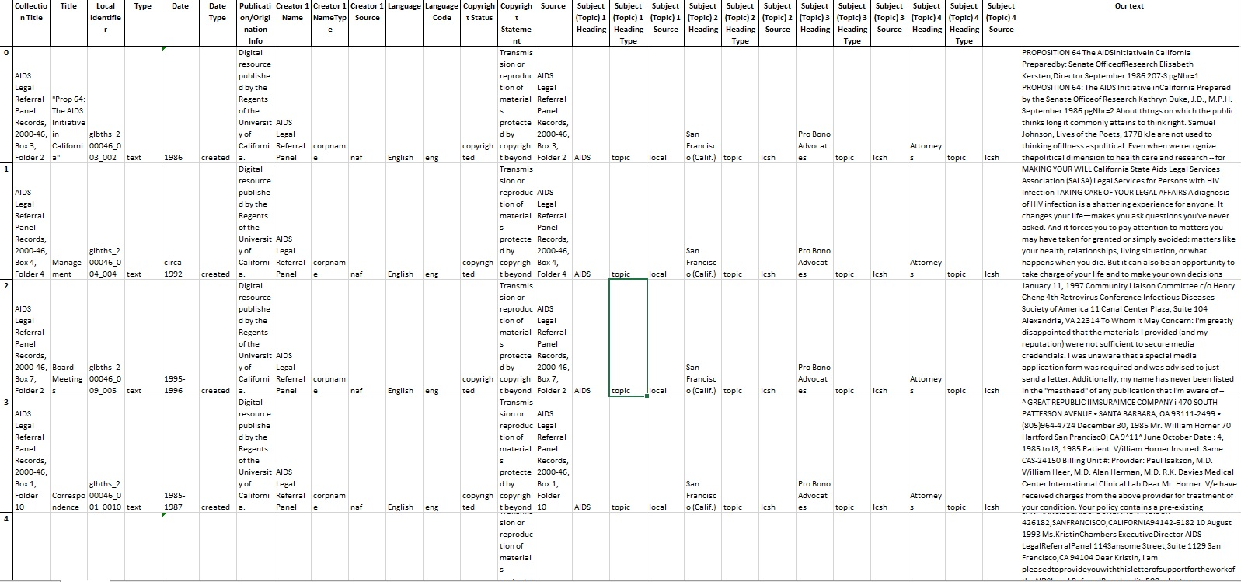
What’s in the data?
It looks like this:

Slide 15
Where do we find the data?
It is online
it is here:
https://doi.org/10.7272/Q6HD7SV7
(we’ll send you the link)

